Slide 1



Service Learning Project
A Description Of The App
In association with
IGiftLife

Slide 2

I Gift Life
It is a non profit organisation, founded in the year 2016 with a save as many lives as possible. They spread the message of organ donation and its merits. The Co- Founders Mr. Tejpal Singh Batra and Ms. Naina Batra have a passion to make this a social movement.

Slide 3


Organ Donation
Organ donation is the process when a person allows an organ of their own to be removed and transplanted to another person, legally, either by consent while the donor is alive or dead with the assent of the next of kin.
Brain Death
Brain death is the complete loss of brain function (including involuntary
activity necessary to sustain life). It differs from persistent vegetative state,
in which the person is alive and some autonomic functions remain.It is
also distinct from an ordinary coma.

Slide 4
Our Aim
TO PROVIDE IGIFTLIFE WITH A APP THAT WILL CONVEY THE INFORMATION REGARDING ORGAN DONATION, BRAIN DEATH, IGIFTLIFE. ALSO T0 PROVIDE A PLATFORM TO APPLY FOR A PLEDGE CARD.

Slide 5

Reqiurements
of the
NGO
LINK TO APPLY FOR PLEDGE CARD
To be linked to the pledge card application on their website.
INFORMATION ABOUT IGIFTLIFE
INFORMATION ABOUT BRAIN DEATH
Basic information about the organisation and its working.
What is brain death? and how is it related to organ donation
INFORMATION REGARDING DONATION
LINK TO CHAT BOX
A link to their AI chat box :: CHAT WITH HOPE.
People who have donated
People who have received

Slide 6

Software Resources
ANDROID APP STUDIO
UNITY
Information Resource
WWW.IGIFTLIFE.COM
WWW.WIKIPEDIA.COM
WWW.YOUTUBE.COM

Slide 7
Supposed look of the App

Slide 8
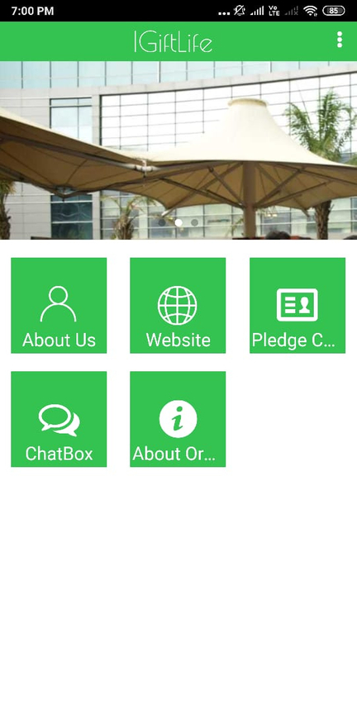
Home Page
INITIAL PAGE WHICH HAS BUTTONS LINKING TO THE OTHER PAGES

Slide 9
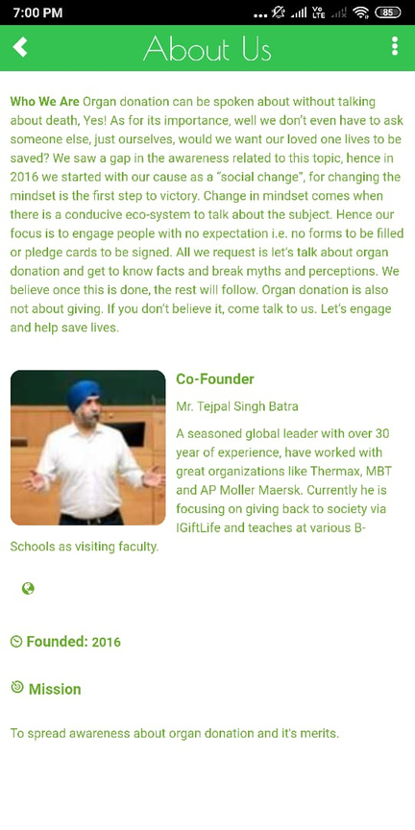
About the Organisation
INFORMATION REGARDING IGIFTLIFE AND IT'S MISSION

Slide 10
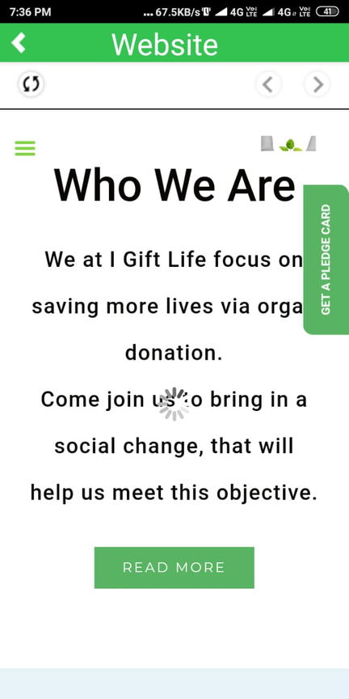
link for website
SEGMENT LINKED TO THE WEBSITE OF THE ORGANISATION

Slide 11
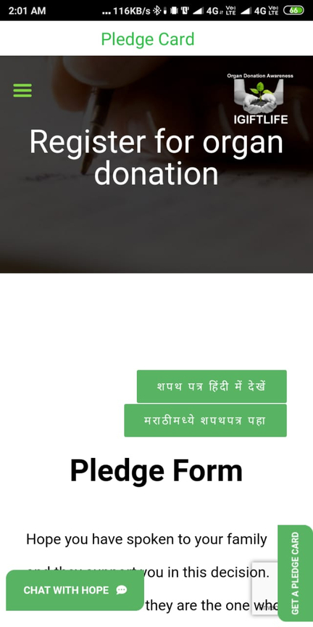
apply for pledge card
SEGMENT LINKED TO A PAGE WHERE WE CAN APPLY FOR A PLEDGE CARD

Slide 12
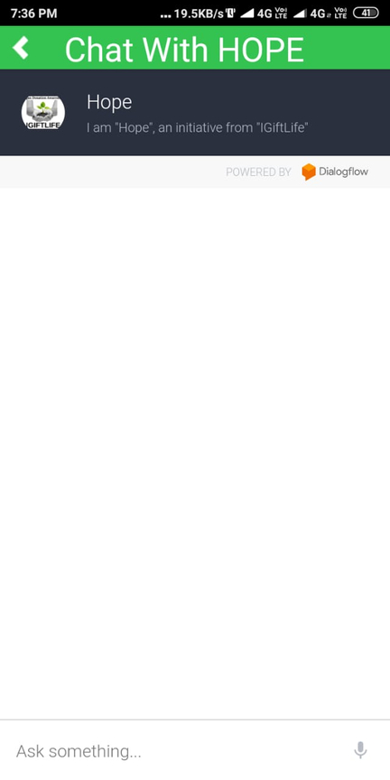
ChatBox
LINK TO THE AI CHAT BOX OF IGIFTLIFE - CHAT WITH HOPE

Slide 13
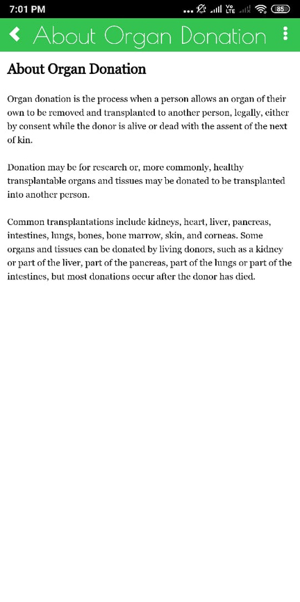
About Organ Dsnation
BASIC INFORMATION REGARDING ORGAN DONATION AND VIDEOS REGARDING IT

Slide 14
Team
AAYUSHI VERMA
18070124003
ARSH RADHANPURA
MR.TEJPAL SINGH BATRA
18070124015
Co-founder and President of IGiftLife
TRIPTI SINGH
18070124074
MS. NAINA BATRA
ROHIT AGGRAWAL
Co-founder and Secretary of IGiftLife
18070124059
SAMARTH SRIVASTAVA
18070124070

